Slide 1






SNAKE ZENXIA
GROUP 16
by
JSL SASI REKHA & EPSHITA SARKAR

Slide 2



Welcome to Snake Xenzia, a classic arcade game brought to life with Python and Pygame!
In this timeless adventure, you'll navigate a slithering snake through a vibrant world filled with delicious fruits.
But beware, for every bite you take brings both joy and challenge.
Introduction

Slide 3



As you venture through the game, your snake grows longer with every fruit it devours.
But with growth comes risk - one wrong move, and your snake will collide with itself or the walls, spelling doom for your reptilian friend.
Can you guide your snake to victory, avoiding the perils that lurk around every corner?
About
Snake Zenxia

Slide 4

MISSION:
Eat as many fruits as you can without crashing into yourself or the boundaries of the game.
Each fruit consumed adds to your score and increases the length of your snake.
Challenge yourself to see how long you can grow and how high you can score!
Goals

Slide 5


Instructions
Navigate through the colorful landscape, seeking out fruits to devour.
1
Use the arrow keys to control the direction of your snake: up, down, left, and right.
2
Watch out for collisions! Avoid running into the walls or crossing paths with your own tail.
3

Slide 6
Instructions
With every fruit eaten, your snake grows longer, making maneuvering trickier.
4
Keep an eye on your score displayed at the top-right corner of the screen.
5
When the game ends, press Enter to play again or Escape to exit.
6

Slide 7
Novelty
Generating different fruits
Audio Effects
Rotating Eyes
Check your Score

Slide 8


Libraries
Pygame
PIL
Time
Random

Slide 9

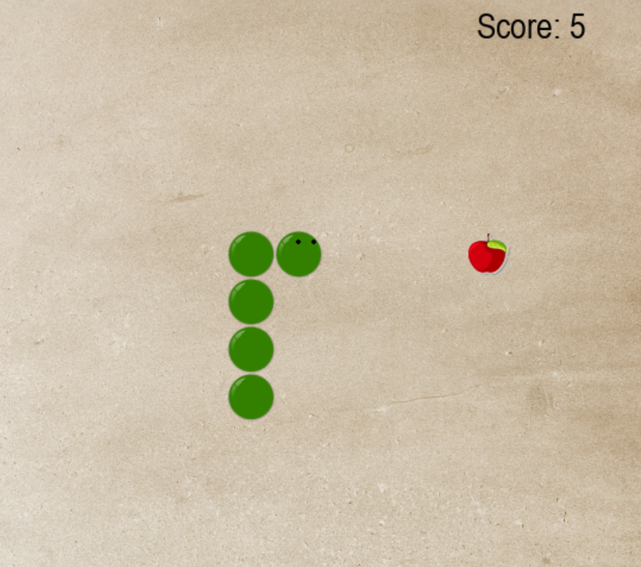
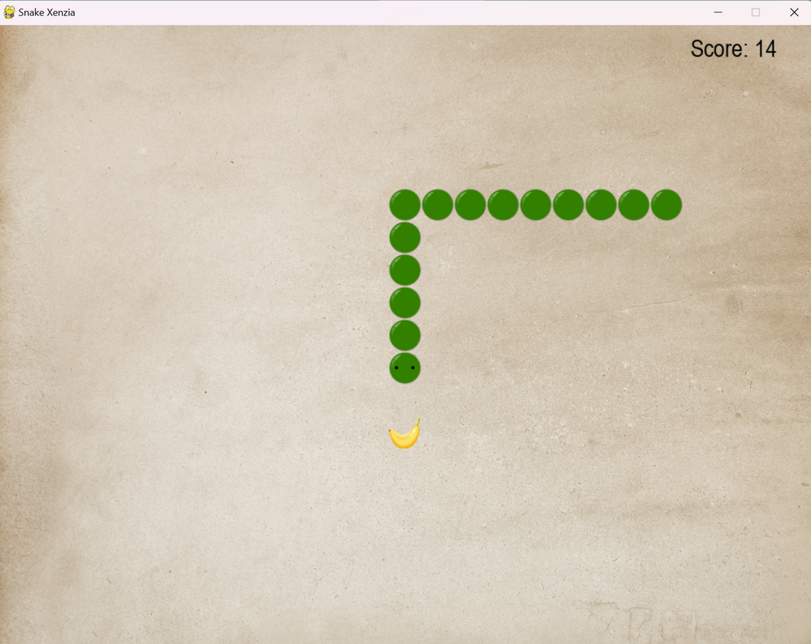
A Look into the Game
Photo 2
Photo 3

Slide 10
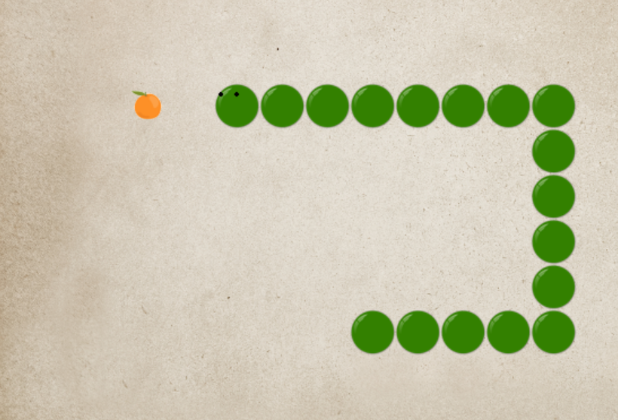
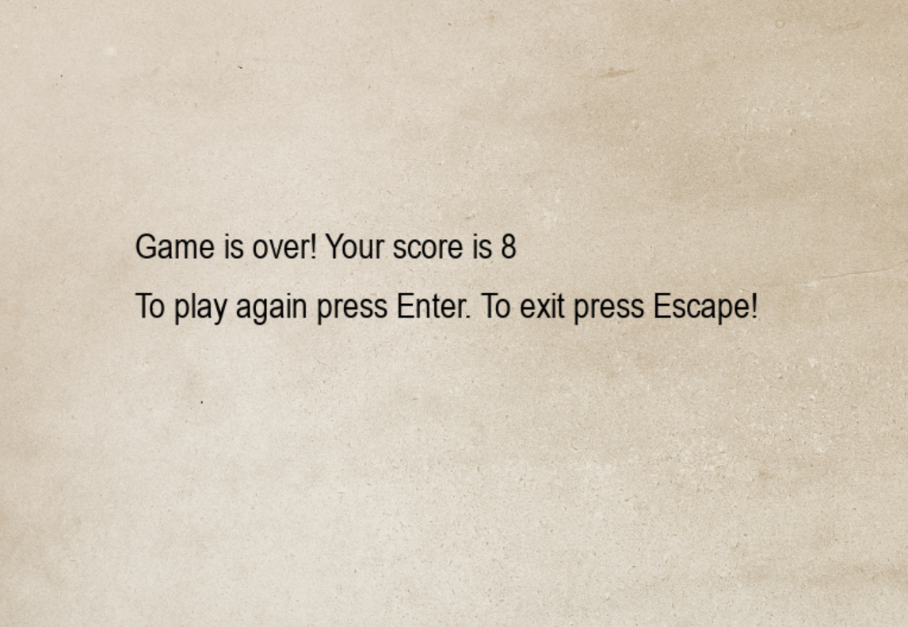
A Look into the Game
Photo 2
Photo 3

Slide 11
Congratulations on completing your adventure in Snake Xenzia!
Whether you reached new heights in your score or faced challenges along the way, your journey through the colorful world of the snake has been an exhilarating one.
With each twist and turn, you've honed your skills and embraced the timeless joy of classic arcade gaming. We hope you've enjoyed this nostalgic experience
and look forward to seeing you again for more adventures in the world of Python and Pygame!
Conclusion

Slide 12
Future Extension
ADD LEVELS
LEADERBOARD
SIGNUP/SIGNIN
USER-FRIENDLY

Slide 13
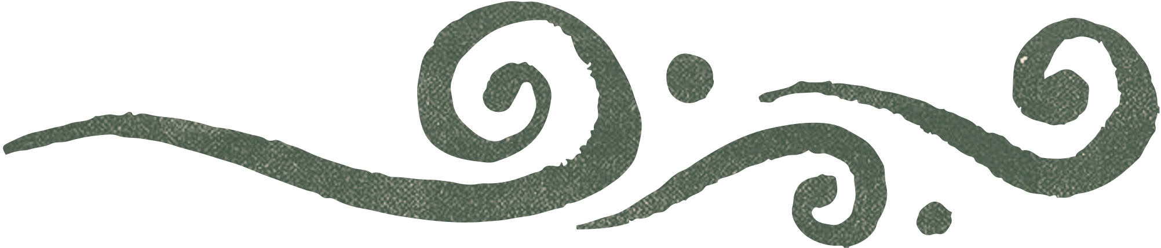
THANK YOU

